Slide 1
Board Game Geek- Requirements Quad
1
Goals and Objective:
Why are we building this dashboard?
2
Audience and Usage:
Who will use this dashboard? How will it be used? What is the problem statement?
To show how board games have changed over time
To give players tools to quickly assess new board games
*To give board game players more insight into their game collection
*To suggest games a board game player may be interested in (stretch goal of the dashboard for later implementation)
Board game enthusiasts
People interested in data applied everyday life
3
Priority Questions:
What are the most important questions that the dashboard needs to address?
4
Features and Functions:
How will this dashboard function to communicate the information?
How have board games changed over time?
Is a particular board game any good?
What board games are the best?
*What board game should I buy next?
All Board Games (Over Time) w/drill down by year
Individual Board game analysis
*Predictive Analysis of what games to add
*Board game collection statistics

Slide 2
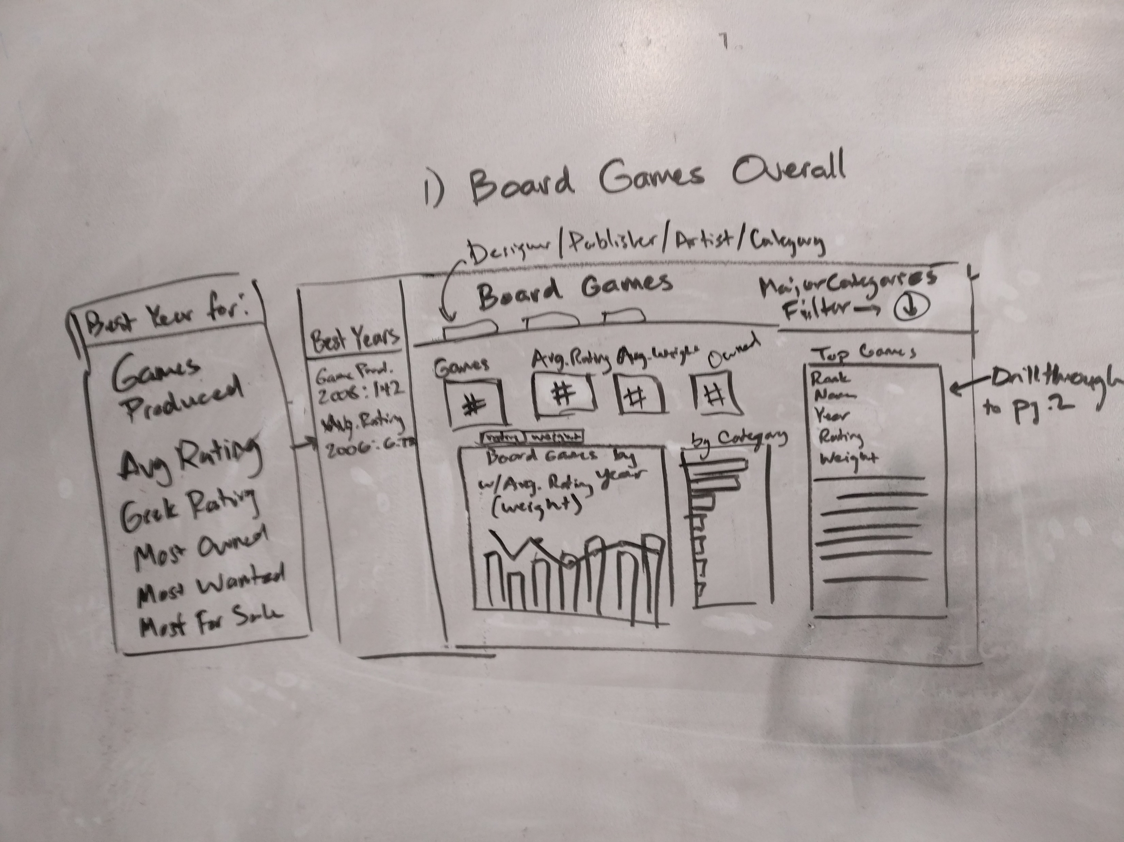
Report Name Here - Wireframe

Slide 3
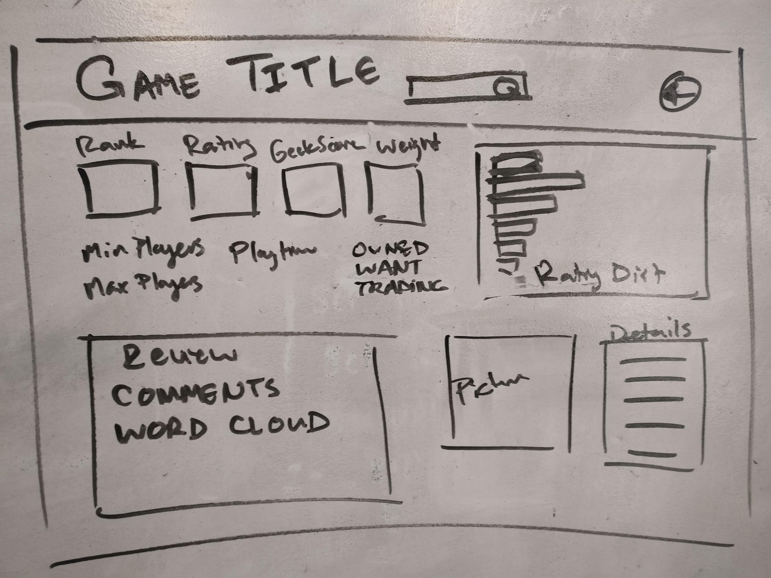
Report Name Here - Wireframe

